Slide 1
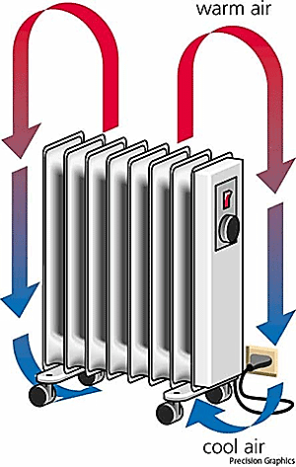
Heat Transfer
Natural convection

Slide 2
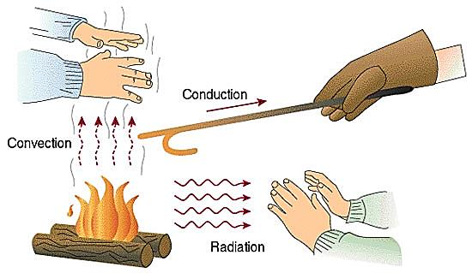
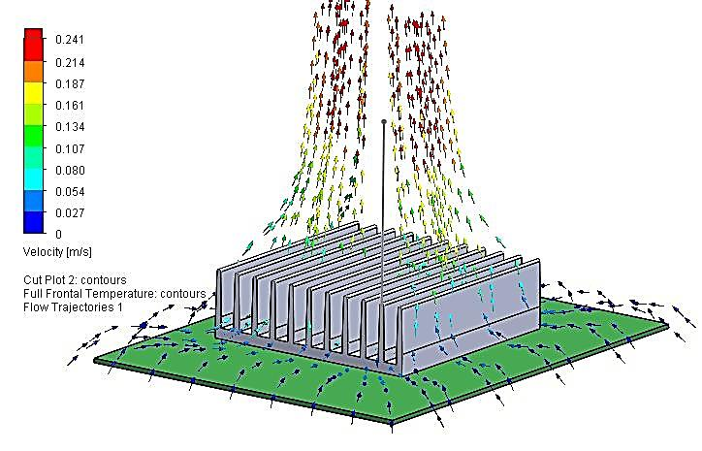

Slide 3
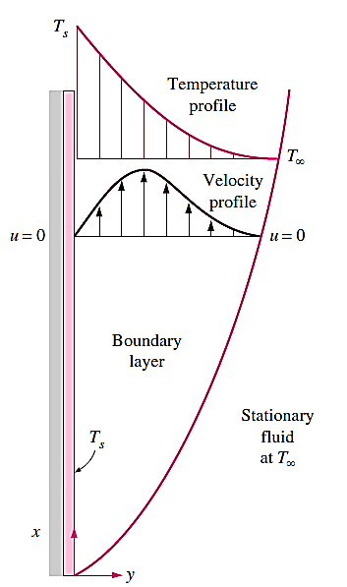
Introduction
'Natural or free convection'; here, fluid movement is caused because of density differences in the fluid due to temperature differences. Under the influence of gravity, density differences cause a 'buoyancy force' which in turn, causes the fluid circulation by 'convection currents'.
Physical Mechanism of Natural Convection
Air in the immediate vicinity of the plate will get heated by conduction; density of this heated air layer decreases. As a result, the heated layer rises up and the cold air from the surroundings moves in to take its place.
During the temperature induced flow, a boundary layer is set up along the length of the plate
at the plate surface, the fluid velocity is zero due to 'no slip' condition; then, the velocity increases to a maximum value and then, drops to zero at the outer edge of the boundary layer since the surrounding air is assumed to be stationary

Slide 4
Dimensionless numbers of natural convection
Gr = Grashoff number: plays the same role in natural convection as that of Reynolds number in forced convection. Physical significance of Grashoff number is that it represents the ratio of buoyancy force to the viscous force acting on the fluid, i.e.
$$Gr=\frac{buoyancy force}{viscous force}=\frac{g.∆ρ.V}{ρ.v^{2}}=\frac{g.β.∆T.V}{v^{2}}$$
$$Gr=\frac{g.β.(T_{s}−T_{a}).L_{c}^{3}}{v^{2}}$$
Prandtl number (Pr) = $\frac{μ cp}{k}$
Rayleigh number, (Ra): Is the Product of Grashoff number and Prandtl number, i.e. $Ra = (Gr.Pr)$. It is the criterion to determine if the flow is laminar or turbulent, in natural convection.
Nusselt number (Nu) = C.Ra^{m}
Where:
Ra = (Gr.Pr) = Rayleigh number and 'C and 'm' are constants determined from experiments, (depending on the convection case).

Slide 5
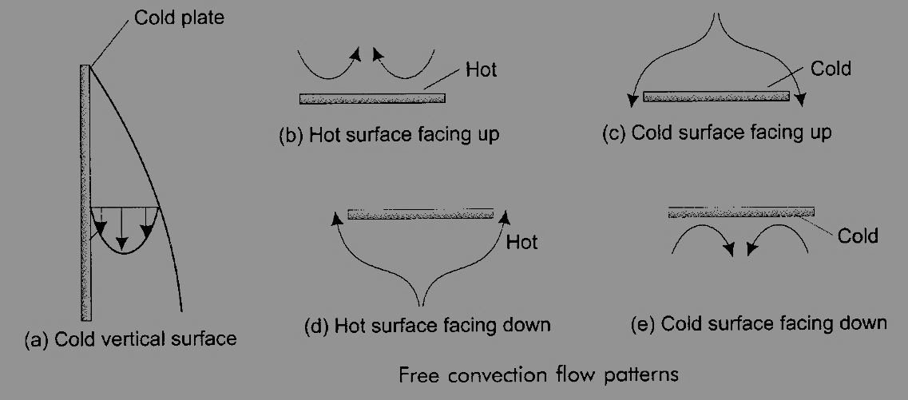
Empirical Relations for Natural Convection over Surfaces and Enclosures
In solving natural convection heat transfer problems, we rely more on empirical relation than on analytical relations. This is due to the fact that analytical relations are rather difficult to obtain also; analytical relations generally give lower values of heat transfer coefficients as compared to empirical relations.

Slide 6
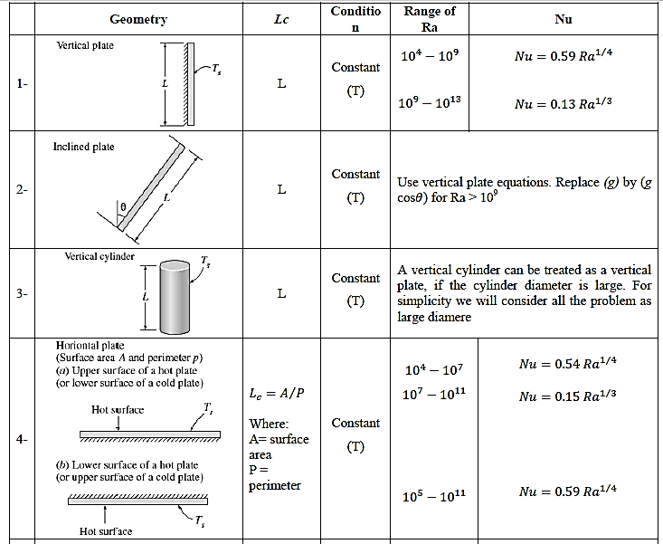

Slide 7
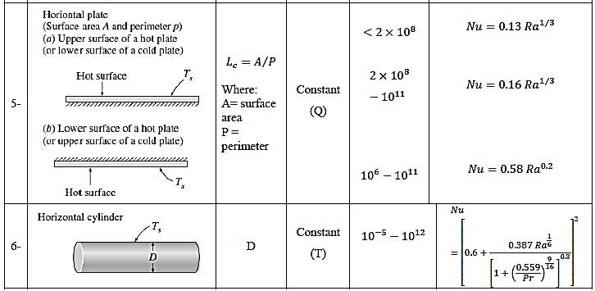

Slide 8
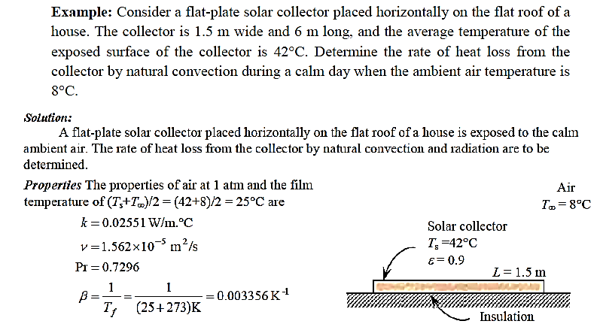

Slide 9
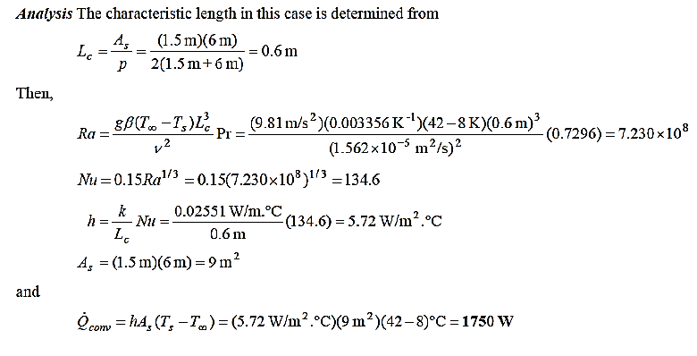

Slide 10
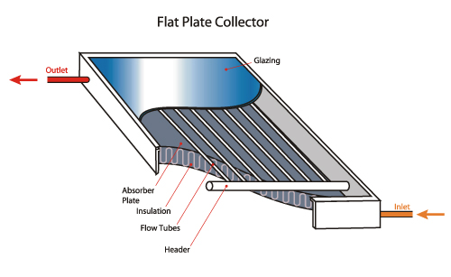

Slide 11
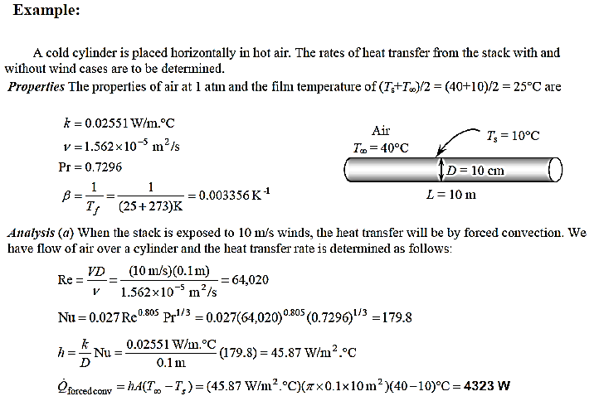

Slide 12
